Slide 1
Towards OWL
Lecture 9

Slide 2
RDF
Statements are represented as triples, consisting of a subject, predicate and object. [S, P, O]
RDF uses URIs - Unique Resource Identifiers to identify resources. (URIRefs)
A URIRef consists of a URI and an optional Fragment Identifier separated from the URI by the hash symbol #.
The RDF Vocabulary - The set of URIRefs used in describing the RDF concepts e.g. rdf:Property, rdf:Resource, rdf:type.

Slide 3
The subject of one statement may be the object of another statement.
A set of linked statements (triples) forms an RDF Graph.

Slide 4
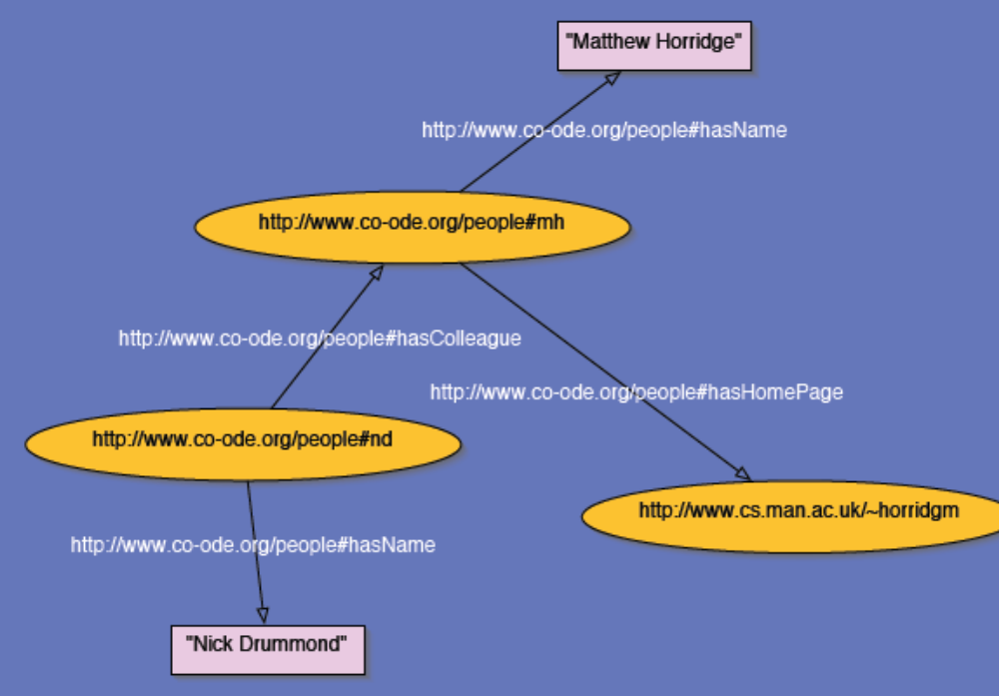

Slide 5
RDFS
RDF Schema ‘semantically extends’ RDF to enable us to talk about classes of resources, and the properties that will be used with them.
It does this by giving special meaning to certain rdf properties and resources.
RDF Schema provides the means to describe application specific RDF vocabularies.
rdfs:Class
rdfs:subClassOf
These are used in conjunction with the rdf:type property.

Slide 6
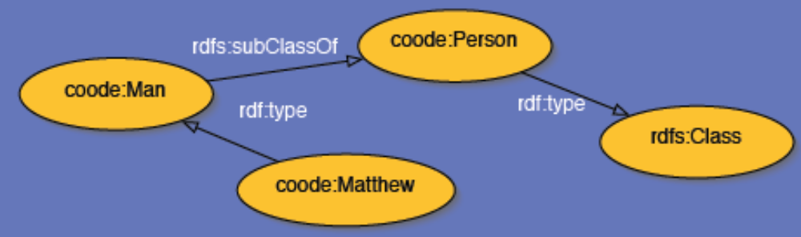

Slide 7
RDF Schema allows us to describe properties. (Properties are instances of the class rdf:Property!)
We can specify a domain using rdfs:domain.
We can specify a range using rdfs:range.

Slide 8
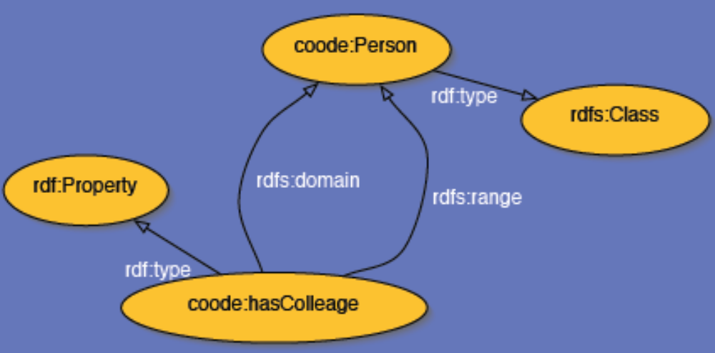

Slide 9
Other RDFS Built-In Properties
rdfs:subPropertyOf
- rdfs:comment
- rdfs:label
- rdfs:seeAlso
- rdfs:isDefinedBy

Slide 10
The RDFS Vocabulary - The set of URIRefs used in describing the RDF Schema langauge e.g. rdfs:Class, rdfs:domain

Slide 11
Summary
RDF - The Resource Description Framework allows us to describe resources by specifying their properties and property values.
RDF Statements are triples of the form [Subject, Predicate, Object]
A set of RDF triples forms an RDF Graph
RDF Schema semantically extends RDF by providing a means to describe RDF Vocabularies.
RDF and RDF Schema provide basic capabilities for describing vocabularies that describe resources.

Slide 12
However, certain other capabilities are desirable e.g
Cardinality constraints, specifying that properties are transitive, specifying inverse properties, specifying the ‘local’ range and/or cardinality for property when used with a given class, the ability to describe new classes by combining existing classes (using intersections and unions), negation (using ‘not’).

Slide 13
Latest standard in ontology languages from the World Wide Web Consortium (W3C).
OWL has a rich set of modeling constructors.

Slide 14
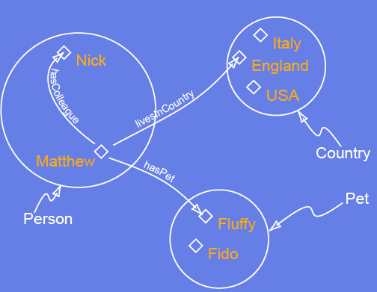
Components of an OWL Ontology
Individuals
Properties
Classes

Slide 15
Reasoning
For ontologies that fall into the scope of OWL-DL, we can use a reasoner to infer information that isn’t explicitly represented in an ontology. Standard ‘reasoning services’ are:
Subsumption testing
Equivalence testing
Consistency testing
Instantiation testing

Slide 16
OWL Classes
OWL is an ontology language that is primarily designed to describe and define classes. Classes are therefore the basic building blocks of an OWL ontology.
OWL supports six main ways of describing classes
The simplest of these is a Named Class. The other types are: Intersection classes, Union classes, Complement classes, Restrictions, Enumerated classes.

Slide 17
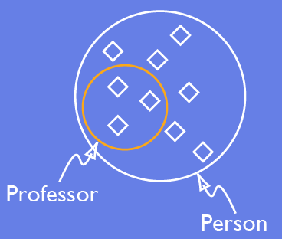
Named Classes

Slide 18
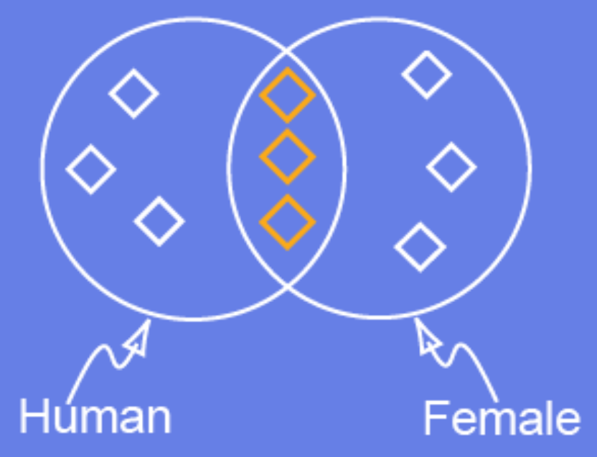
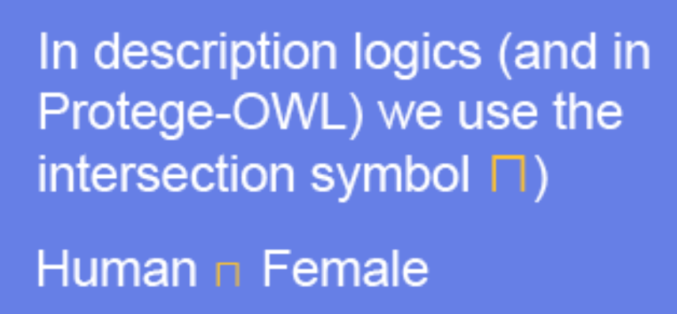
Intersection Classes
Intersection Classes are formed by combining two or more classes with the intersection (AND) operator.

Slide 19
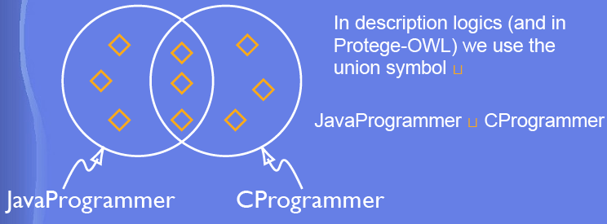
Union Classes
Union Classes are formed using the union (OR) operator with two or more classes.

Slide 20
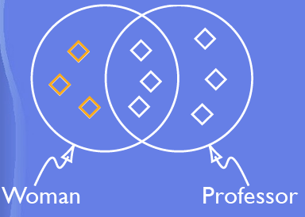
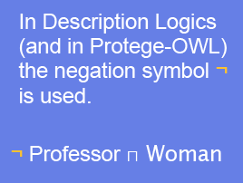
Complement Classes
A complement class is specified by negating another class. It will contain the individuals that are not in the negated class.

Slide 21
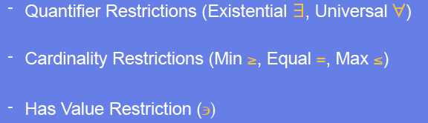
Restrictions
Restrictions describe a class of individuals based on the type and possibly number of relationships that they participate in.
Restrictions can be grouped into three main categories:

Slide 22
Existential Restrictions
The most common type of restriction we will use is an existential restriction, which has the symbol ∃ (backwards E).
The existential restriction means ‘some values from’, or at least one.
An existential restriction describes the class of individuals that have at least one kind of relationship along a specified property to an individual that is a member of a specified class.

Slide 23
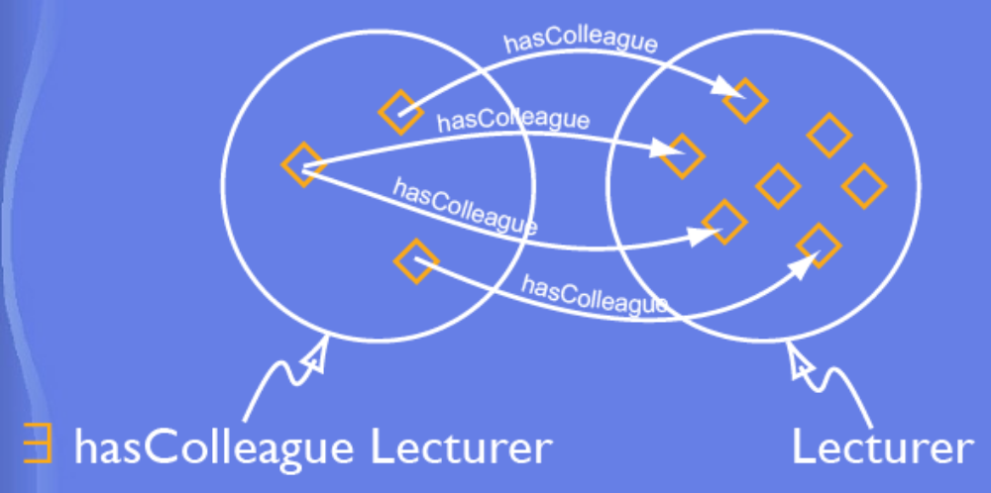
Existential Restrictions

Slide 24
Universal Restrictions
Universal - ∀ (upside down A) ‘all values from’, or only. For a given property, all the individuals must be members of a specified class.

Slide 25
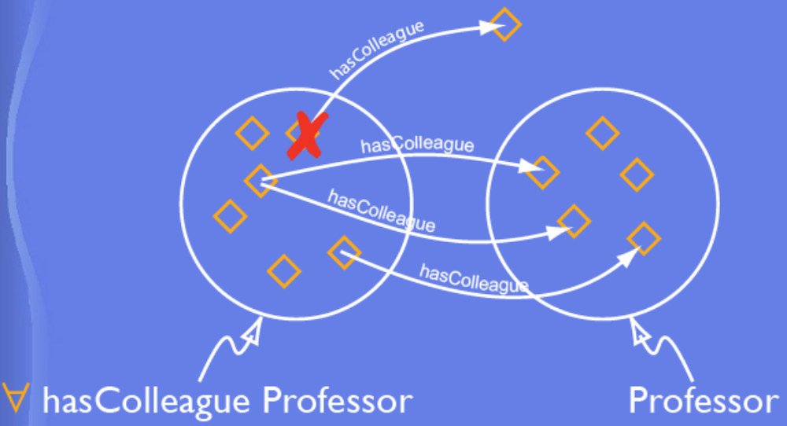

Slide 26
Other Restrictions
Cardinality Restrictions - For a given property, cardinality restrictions allow us to talk about the number of relationships that a class of individuals participate in.
Has Value Restrictions - Allow us to specify that class of individuals that participate in a specified relationship with a specific individual.

Slide 27
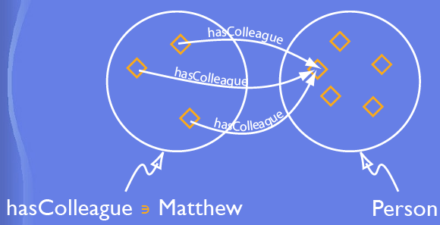
hasValue Restriction Example

Slide 28
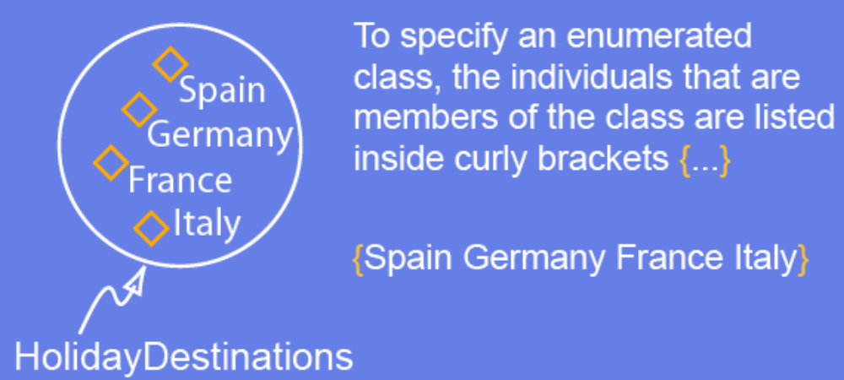
Enumeration Classes
An enumeration class is specified by explicitly and exhaustively listing the individuals that are members of the enumeration class.

Slide 29
Properties
There are two main categories of properties: Object properties and datatype properties.
Object properties link individuals to individuals.
Data type properties link individuals to datatype values (e.g. integers, floats, strings).
Object properties my have an inverse property e.g. the inverse of worksFor might be employs.
Properties can have as specified domain and range.

Slide 30
Property Characteristics
We can specify certain property characteristics.
  Functional - For a given individual, the property takes only one value.
  Inverse functional - The inverse of the property is functional.
  Symmetric - If a property links A to B then it can be inferred that it links B to A.
  Transitive - If a property links A to B and B to C then it can be inferred that it links A to C.

